Slide 1
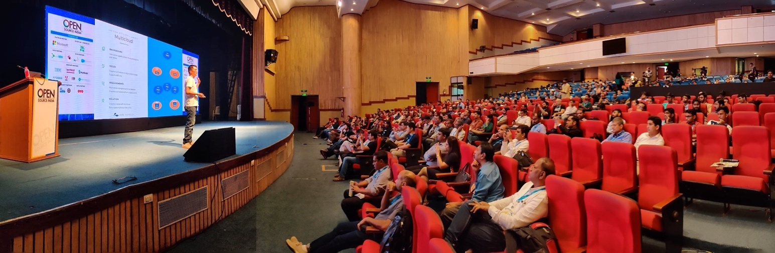
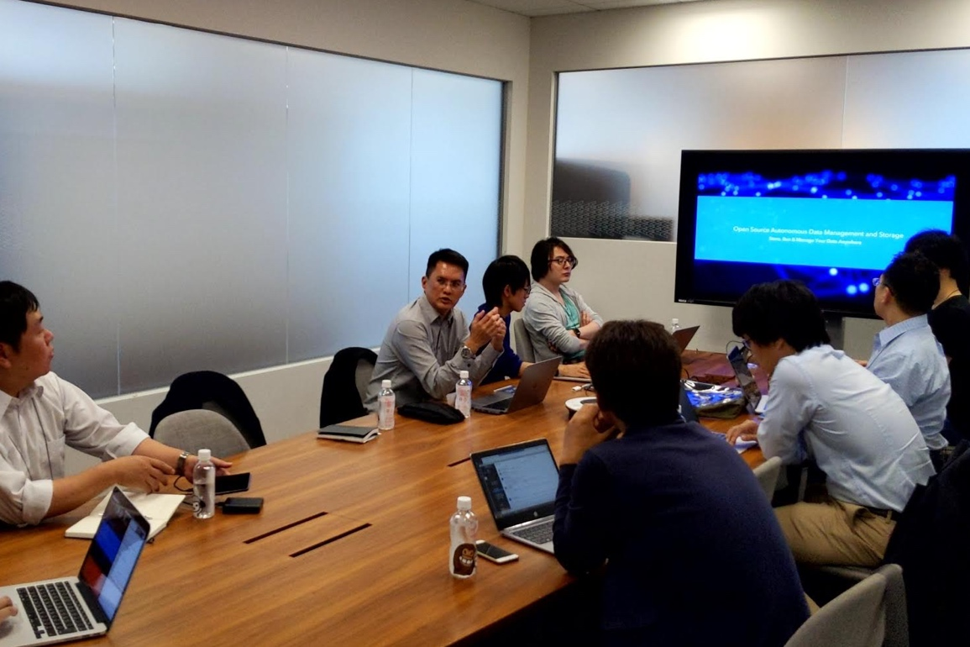


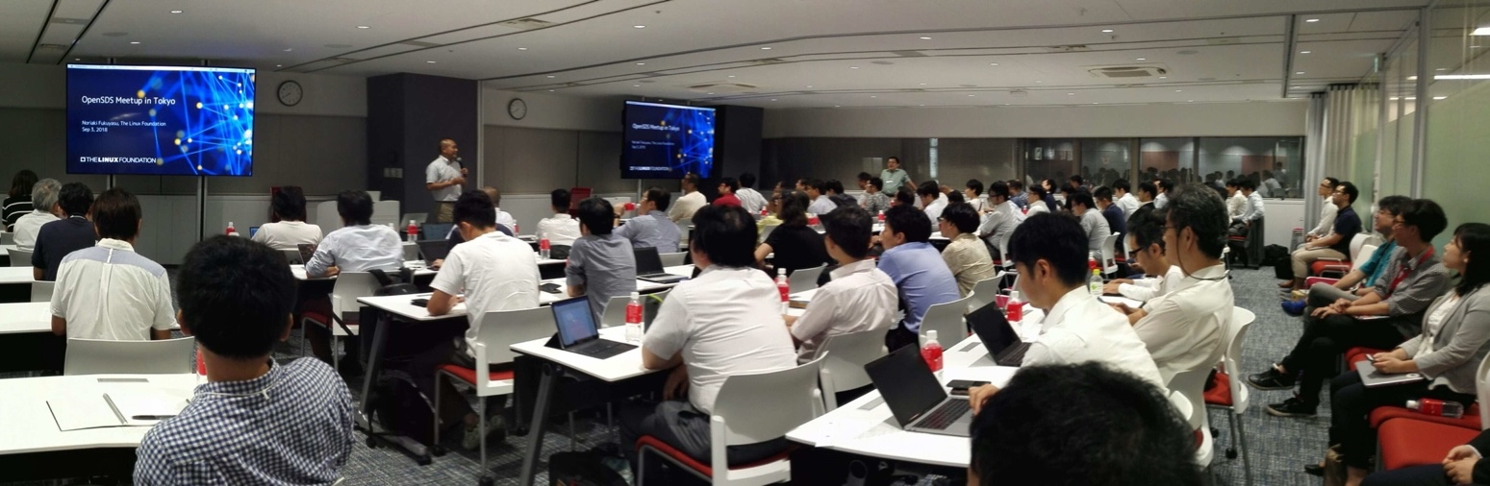

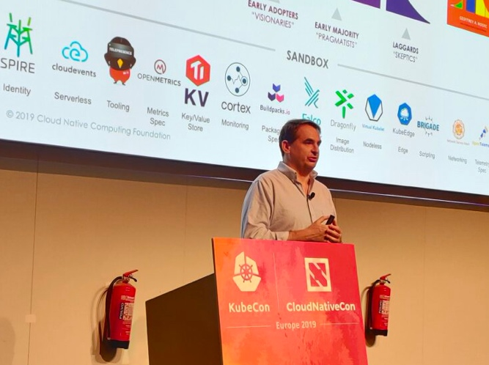
1) Year end meeting 2018 hosted by Toyota 2) Cosimo Rosettti (Vodafone) speaking at OpenSDS Mini Summit, Prague 2017 3) Wim Jacobs (KPN) speaking at OpenSDS Mini Summit, Copenhagen 2018 4). Steven Tan (SODA Chair) SODA keynote at Open Source India , Bengaluru 2019 5) OpenSDS Meetup hosted at RedHat, Tokyo, 2018 6) SODA booth staff, Open Source Summit, Lyon 2019 7) Yuji Yazawa (Toyota) speaking at SODA Forum, Tokyo 2019 8) Steven Tan (Futurewei) OpenSDS keynote at Open Source Summit, Berlin 2016
PAST EVENTS
6
1
1
4
7
2
8
3
5
3
Ecosystem Philosophy
SODA
ARM
AI for Data Infrastructure
Open Storage
Extreme Automation
Data Lakes for Big Data & AI

Slide 2
THANK YOU
http://www.sodafoundation.io/
https://github.com/sodafoundation
Twitter: @sodafoundation
Ecosystem Philosophy
SODA
ARM
AI for Data Infrastructure
Open Storage
Extreme Automation
Data Lakes for Big Data & AI

Slide 3
AI for Data Infrastructure

Slide 4
AI for Data Infrastructure
Key Messages
Proliferation of data and applications imposes significant challenges for data infrastructure management
Huawei’s DMS solution embeds AI across the cloud, data center, and device tiers for intelligent operations and management
Machine learning models can be used to optimize data center operations, improve system performance, and reduce total cost of ownership
Ecosystem Philosophy
SODA
ARM
AI for Data Infrastructure
Open Storage
Data Lakes for Big Data & AI
Notes:
The proliferation of data and applications imposes significant challenges for data infrastructure management. The DMS solution embeds AI across the cloud, data center, and device tiers for intelligent operations and management. Machine learning models can be used to optimize data center operations, improve system performance, and reduce total cost of ownership.

Slide 5









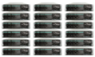
Explosive Data Growth Poses Challenges to Storage
Explosive data growth
Diversified applications
Complex O&M
Traditional applications
Cloud application
Fault analytics
175 ZB
kubernetes
Insufficient performance
Insufficient capacity
32 ZB
Task change
Continuous alarms
Fault reporting
Fault locating
2018
2025
SAN
NAS
AFA
Scale-out block
Scale-out NAS
Object
Centralized storage
distributed storage
Export report
Only 2% of 180 ZB data around the world can be stored and read
Siloed architecture results in complicated resource allocation
Massive management devices for complex O&M
Poor accessibility + utility
Insufficient management capability
Low O&M efficiency
Ecosystem Philosophy
SODA
ARM
AI for Data Infrastructure
Open Storage
Data Lakes for Big Data & AI
Notes:
Data center operations and storage management are becoming ever complex due to the explosive growth of data and the proliferation of applications. Service rollout takes a long time, resource utilization is low, problem resolution is passive and reactive, and the service level cannot be guaranteed. Operational expenses are very high and account for 65% of the total cost of ownership.

Slide 6





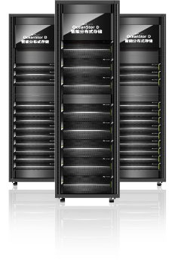

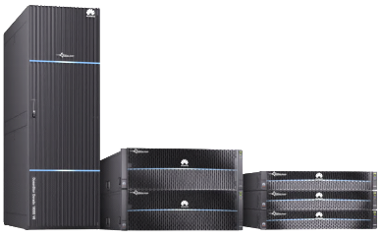
Embracing AI for Data Infrastructure Management
DMS
Cloud
eService
Mobile
Cloud AI
Remote Maintenance
Call Home
Historical data
Automatic order
eService
Data Center AI
Automated Management
Plan
Operate
Maintain
Optimize
Smart Production
Smart Data Analysis
Smart Edge
Automation
Policy
Analysis
Prediction
DJ
DME
FDM
DME
FCV
DME
DME
Device AI
Simple Configuration
GaussDB T
FusionInsight
GaussDB A
OceanStor
Self-learning
Self-Optimization
Device
DB Manager
FusionInsight Manager
DeviceManager
Ecosystem Philosophy
SODA
ARM
AI for Data Infrastructure
Open Storage
Data Lakes for Big Data & AI
Notes:
DMS is a solution for the intelligent management of data infrastructure. It supports autonomous operations and reduces operational overhead, by embedding AI across three tiers: the cloud tier, the data center tier, and the device tier. On the cloud tier is the eService Cloud-based Management System. eService provides a cloud portal for around-the-clock monitoring and reporting. On the data center tier is the DME product that automates the management of datacenter infrastructure as a whole. On the device tier, AI chips and algorithms are built into the storage products, to enable self-learning and self-optimization and to simplify system configuration.

Slide 7
Cloud AI for Online Intelligent O&M
14
days
Cross-domain
Empirical model
Interaction model
Efficiency model
Fault model
AI model training
Cloud AI
(eService)
Cloud AI
Data scientists and algorithm developers
Disk fault prediction
Global autonomy
Unified model & training
365
days
Engineering
Interface technology
Data infrastructure
Device
Management & control center
Data collection
AI inference & analytics
Capacity prediction
Cloud-native platform
Center autonomy
Model
Data
93%
Center AI
Device
Data
Device
Data
…
Data
Data
Device AI
Device
Device
Intelligent fault diagnosis
2,000+ fault modes library
2 PB+
feature data
1,000+ application scenarios
Ecosystem Philosophy
SODA
ARM
AI for Data Infrastructure
Open Storage
Data Lakes for Big Data & AI
Notes:
The eService that implements Cloud AI aggregates resource and usage data from global data centers and builds a variety of machine learning models. The models are shared with data centers for optimizing data center operations. To date, the eService has been independently deployed in three major regions of Huawei Cloud: China, Mexico, and Germany. It is able to predict disk failures over the next two weeks, and automatically create service tickets to track disk replacement. It is able to predict storage needs for the next 12 months, and give detailed expansion recommendations. It is also able to successfully diagnose 93% of the problems.

Slide 8





Center AI for Automated Full Lifecycle Management
Cloud AI
Planning
SLA definition
App template
Initial investment
Model
Data
20%
Center AI
Deployment efficiency
Deployment
Remote deployment
Automated provisioning
Scenario recognition
Prediction and prevention
Real-time control
10x
DME
Root cause analytics
Data analytics and AI inference
O&M
Automated fault rectification
Fault closed loop
Risk prediction
60%
Data collection/filtering/association
Resource utilization
Control
Data
Optimization
Performance optimization
Device AI
Resource reclamation
80%
Ecosystem Philosophy
SODA
ARM
AI for Data Infrastructure
Open Storage
Data Lakes for Big Data & AI
Notes:
Datacenter AI is enabled by the DME product. DME automates the lifecycle management of the datacenter, including planning, deployment, operations, and optimization. DME performs data analytics and AI inferencing based on data collected on the datacenter resources. It is able to reduce capital expenses by 20%, improve deployment efficiency by 10 fold, automatically handle 60% of the faults, and improve resource utilization by 80%.

Slide 9

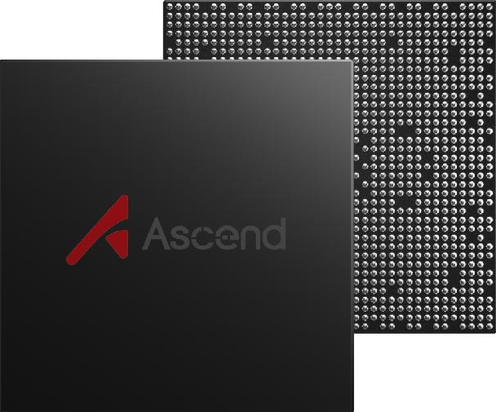
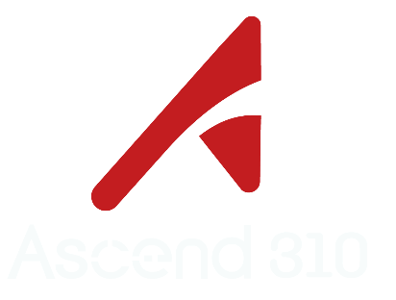

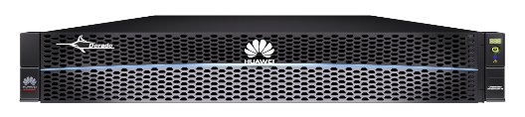

Device AI for Increasingly Fast Storage
Cloud AI
Blazing-fast performance
Smart cache for 20% higher performance
Center AI
Device AI
Uses machine learning to identify semantics-related I/Os
Optimal reduction ratio
Intelligent deduplication for 50% deduplication ratio
Ascend 310 AI chip
Da Vinci architecture
FP16: 8 teraFLOPS
INT8: 16 teraFLOPS
Max power: 8 W
Adaptive inline and post-process deduplication; Byte-level and variable-length deduplication
Online learning
Simplified deployment
Deployment steps slashed from 15 to 3 operations completed in 90% less time
Offline training
Real-time collection
Feedback and optimization
ML/DL architecture and algorithm platform
Ecosystem Philosophy
SODA
ARM
AI for Data Infrastructure
Open Storage
Data Lakes for Big Data & AI
Notes:
Device AI is implemented on storage devices. Huawei’s latest storage products have an Ascend 310 AI chip embedded. Device AI improves cache hit rate by 50%, achieves 80% data reduction, and reduces the deployment process from 15 to 3 operations and shortens deployment time by up to 90%.

Slide 10
Data Lakes for Big Data and AI Acceleration

Slide 11
Data Lakes for Big Data and AI Acceleration
Key Messages
Siloed enterprise data must be integrated before it can be used in big data and AI applications
Data lakes are an important notion for integrating big data, leveraging the Hadoop and Spark ecosystem
The data lake architecture has evolved over time in order to address the business needs and regulatory requirements
Ecosystem Philosophy
SODA
ARM
AI for Data Infrastructure
Open Storage
Data Lakes for Big Data & AI
Notes:
Enterprise data is siloed, which must be integrated before it can be used in big data and AI applications. Data lakes are an important notion for integrating big data, leveraging the Hadoop and Spark ecosystem. The data lake architecture has evolved over time in order to address the business needs and regulatory requirements.

Slide 12
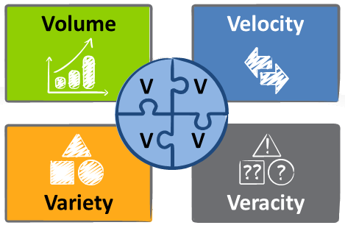
Big Data Presents a Big Problem of Integration
Machine learning assumes the availability of a coherent dataset
But 80% of companies report a high or moderate degree of data silos (CompTIA)
The Four V’s of big data makes integration difficult
175 Zettabytes of data will be generated annually by 2025 (IDC)
1.7 MB of data is created for every person on earth every second (DOMO)
Big Data
Unstructured data makes up 80%+ of enterprise data (Datamation)
Only 3% of enterprise data meets basic quality standards (HBR)
Ecosystem Philosophy
SODA
ARM
AI for Data Infrastructure
Open Storage
Data Lakes for Big Data & AI
Notes:
Big data and AI applications depend on massive amounts of high-quality data. Enterprise data is siloed and spreads across many repositories. Siloed data must be integrated before it can be used in applications. The integration is very difficult, due to the four-V characteristics of big data: volume, velocity, variety, and veracity.

Slide 13

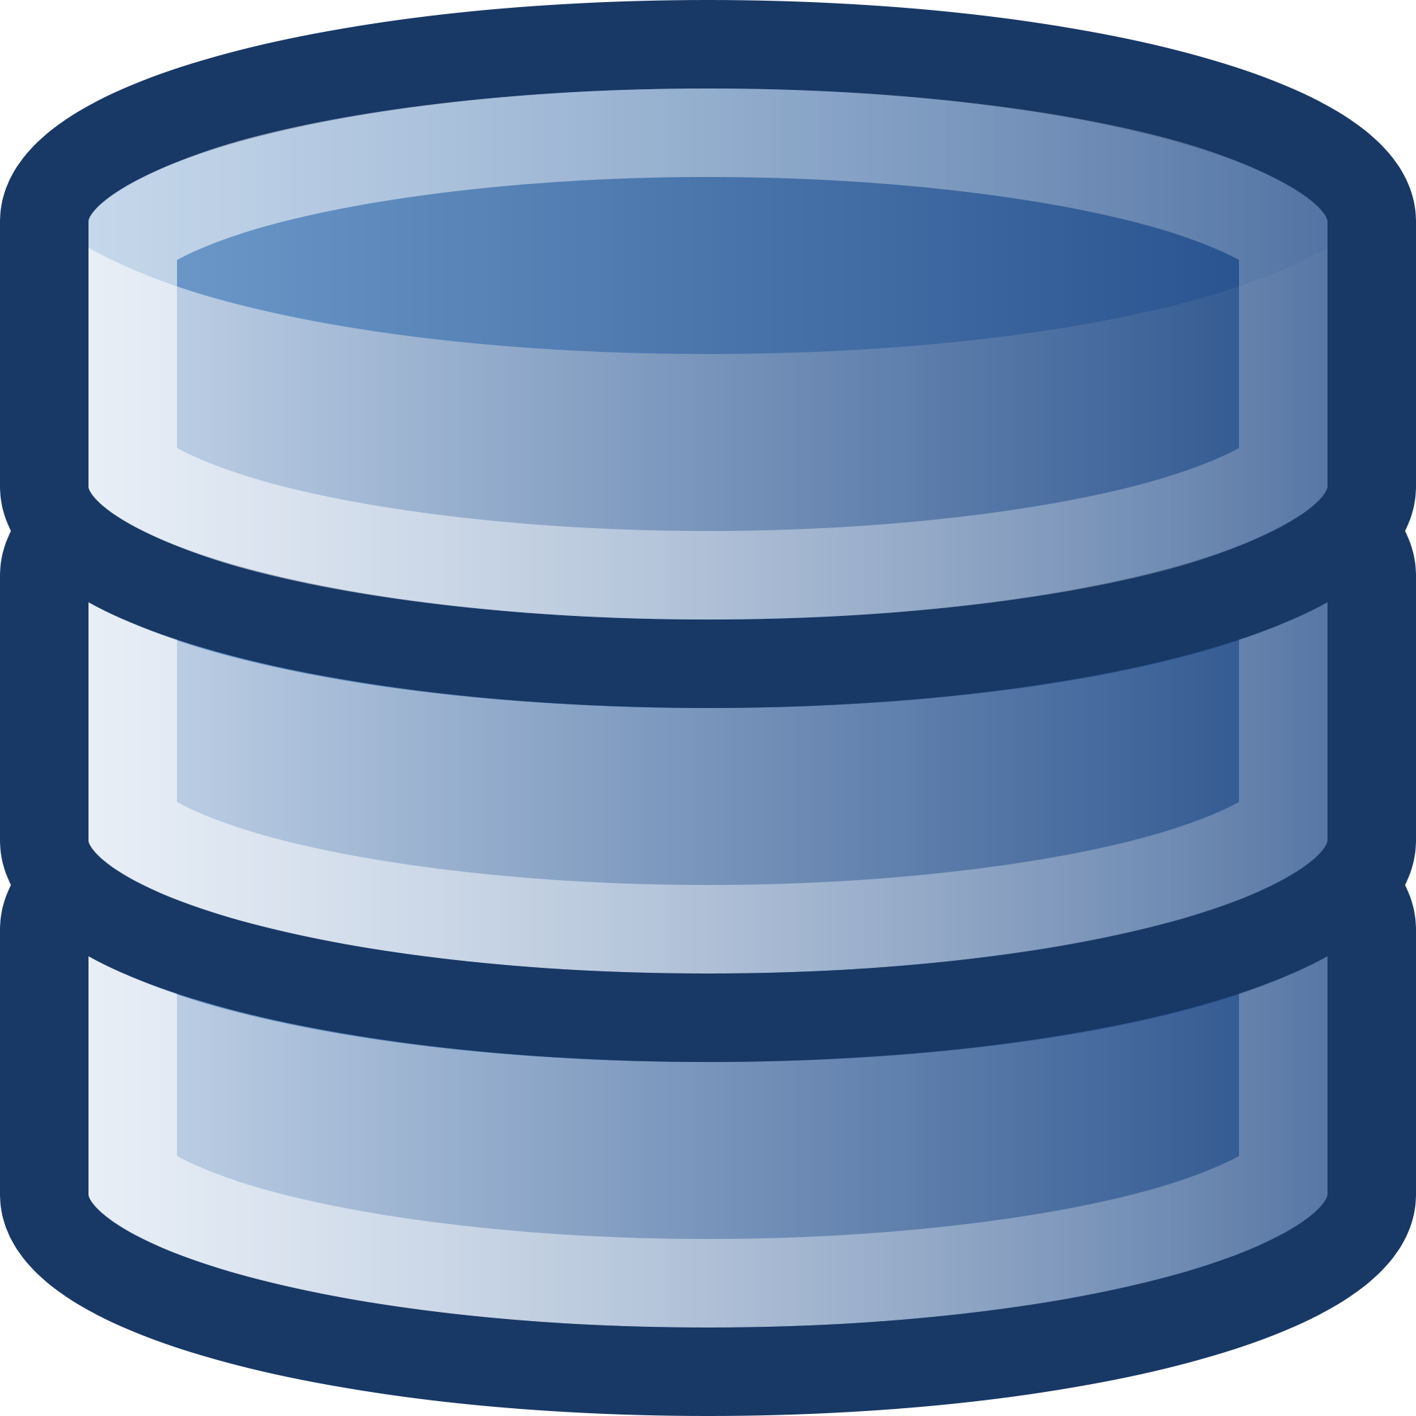




Data Integration: Past, Present, and Future
EL
Data Warehouses
Data Lakes
Enterprise Data Lakes
Virtual Data Lakes
GaussDB 200
FusionInsight
Delta Lake
Hetu Engine
Ecosystem Philosophy
SODA
ARM
AI for Data Infrastructure
Open Storage
Data Lakes for Big Data & AI
Notes:
Data integration has evolved over time. A traditional approach was data warehousing for the integration of structured data. Then came the notion of data lakes, which was introduced along with Hadoop for the integration of big data. Enterprise data lakes built on the original data lakes and provided the additional data management features required to meet the business and regulatory requirements. Most recently, virtual data lakes have gained good traction as they addressed several key limitations of the data lake architecture.

Slide 14









Data Integration via a Data Lake
EL
Data Lake
Structured
Semi-Structured
Unstructured
AWS S3
ADLS
Data Lakes
Centralized repository based on HDFS or object stores
All modalities of raw data stored in native format
Data processing and analysis with Hadoop and Spark
Issues
Difficult to discover and understand data
Inadequate for streaming and interactive queries
No support for transactions or data quality control
Delayed and duplicate data transformation
Ecosystem Philosophy
SODA
ARM
AI for Data Infrastructure
Open Storage
Data Lakes for Big Data & AI
Notes:
The Hadoop and Spark movement brings about the data lake approach to data integration. A data lake is a centralized repository based on HDFS or an object store, and is used to store structured, semi-structured and unstructured data in its raw, native format. Data is loaded into the lake without any transformation or pre-determined use, and no schema is imposed on lake data. Data in the lake can be processed using an extensive portfolio of tools in the Hadoop and Spark ecosystem. Data lakes are typically deployed on inexpensive hardware and are highly scalable and flexible.

Slide 15





Data Integration via an Enterprise Data Lake
EL
Enterprise Data Lake
Batch Processing
Stream Processing
Query Processing
Raw
Curated
Production
Batch Data
Catalog
Schema
Transactions
Quality
Security
Streaming Data
AWS S3
ADLS
Enterprise Data Lakes
DBMS features layered on low-cost data lake storage
Unification of batch, stream, and query processing
Multi-zone support for raw, curated, and production data
Issues
Compromised functions and performance
Data duplication across source data and multiple zones
Inability to integrate external data that cannot be copied
Ecosystem Philosophy
SODA
ARM
AI for Data Infrastructure
Open Storage
Data Lakes for Big Data & AI
Notes:
A recent surge of efforts promises to mitigate the issues in data lakes. This has resulted in a new architectural pattern, which we can call enterprise data lakes. The basic idea is to put a layer of data management features on top of the storage system in a data lake. The added data management features are similar to those in a traditional database and may include data catalogs, schema enforcement, transaction support, quality management, security control, and audit trails. It is also common for an enterprise data lake to support the ingestion of streaming data natively, and to allow all of batch processing, stream processing and query processing against data in the lake. An enterprise data lake can be used to store not just raw data, but also transformed and integrated data. In particular, it can be organized into three zones: a bronze zone for raw data, a silver zone for curated data, and a gold zone for production data tailored to specific business needs.

Slide 16

Data Integration via a Virtual Data Lake
EL
Metadata Integration
Data Virtualization
Privacy Protection
Virtual Data Lake
Data Access Abstraction
Execution Orchestration
Org 3
Data Orchestration
Org 2
Org 1
Data Warehouses
Enterprise Data Lakes
Other Data Sources
Virtual Data Lakes
Unification of data silos without having to duplicate data
Physical or virtual integration of metadata
Orchestration of data processing and soft-state distribution
Preservation of investment in data warehouses and lakes
Challenges
Human involvement in data curation and governance
Performance issues due to separate compute and storage
Privacy of data subjects and owners
Ecosystem Philosophy
SODA
ARM
AI for Data Infrastructure
Open Storage
Data Lakes for Big Data & AI
Notes:
Virtual data lakes represent the latest development. A virtual data lake provides unified access to siloed data, regardless of its location and format, and without having to replicate data. It can be connected to existing data warehouses, enterprise data lakes, and other data sources. A virtual data lake integrates metadata from different sources and provides a consolidated view on all data assets. It masks the heterogeneity of the connected sources, and orchestrates data processing across a virtualization engine and the source systems. A virtual lake shortens development cycles and reduces operational costs when compared to a physical lake. It also preserves investment in legacy data warehouses and data lakes and increases the return on investment.

Slide 17
Open Storage and Computing Architecture

Slide 18
Open Storage and Computing Architecture
Key Messages
IT industry landscape is changing rapidly due to 5G, AI, and Edge/IoT etc.
Huawei will partner with the customers to deploy our leading-edge solutions
Huawei will stay open minded, and endorse an open IT architecture
Tips
Consider the audience: Industry relevance, technical vs business level
Here is a place where you can emphasize a major customer “pain point”
Customize the applications/services as appropriate
Ecosystem Philosophy
SODA
ARM
AI for Data Infrastructure
Open Storage
Data Lakes for Big Data & AI
Notes:
Growth is accelerating due to technologies like 5G, AI, and Edge/IoT
We need to change, since the current model does not scale
Huawei will partner with the customers to deploy our leading-edge solution
One Storage, One Lake architecture and One Data feature
OpenAPIs, Open Source ecosystem support, partnerships and collaboration

Slide 19
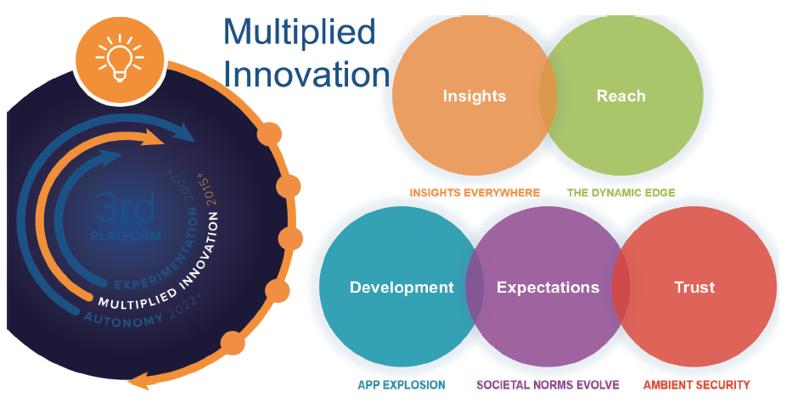
Challenges to Computing Platforms
The IT Industry is Changing Rapidly
IDC's proposed a new platform that is in the phase of multiplied innovation
epitomized by intelligence, cloud computing, big data, mobility, and social
networks.
Collaboration across cloud-edge-devices becoming a trend
Explosion in number of apps
5G will exponentially improve connection density
The connection explosion and its data explosion need intelligent, real-time processing
Collaboration from edge to cloud involving huge amount of data and different vendors requires an open and efficient platform
Ecosystem Philosophy
SODA
ARM
AI for Data Infrastructure
Open Storage
Data Lakes for Big Data & AI
Notes:
Key message: Huge data, huge amount of apps, huge amount of interactions between apps, layers, sites
Talk about following numbers to emphasize the cloud transition:
Some CAGR (5-year compound annual growth rate) numbers: global, China
Server: 3.7%, 12.4%
Enterprise storage: 1%, 6.9%
Basic software: 5.3%
Database: 7.5, 26.9%
Middleware: 10.3, 15.7%
Bigdata platform software: 15.6%, 44.7%
Enterprise software: 8.2, 11.7%
Cloud service: 31.4, 44.8%
Raise ADAS example for data explosion: per vehicle data is estimated between 60-70TB per day

Slide 20
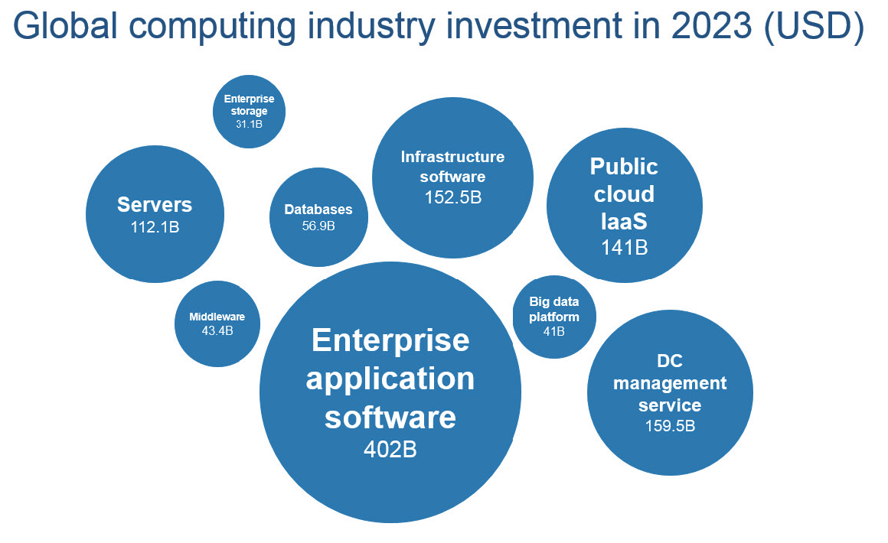
Meeting the Challenges with Open Storage and Computing Architectures
One Step Forward from Open Source
Industry is investing heavily into upgrading the computing and storage infrastructure
Hardware, software, services will all evolve to adapt to the new era
Computing and storage industry has both challenges and opportunities
Open standards encourages competition and innovation, and most importantly, making collaboration possible across vendor boundary
No vendor lock-in means huge savings for enterprise customers
Ecosystem Philosophy
SODA
ARM
AI for Data Infrastructure
Open Storage
Data Lakes for Big Data & AI
Notes:
Key message: Open source is not enough, we also need to build an open architecture that help everyone to integration and collaborate.
This can also be considered as app development offloading to lower level equipment / service provider such as Huawei
The ultimate goal is to make app dev, integration and use easier for enterprise users.
Raise an example to explain how open interface like CSI (Container Storage Interface) make app development more efficient.
CSI provide a standardized API for container level applications to call advanced storage feature like create, delete or manage volume / snapshot, avoid the need of vendor specific development at application layer.
Hardware – Huawei is actively working on ARM and RISC-V; on storage front, Huawei support current open standards and framework like CSI, Cinder, and also actively participating in future open source projects like SODA.

